Slide 1


GDSC EPITA
Introduction to Docker
Monday 21th November 2022
Mickaël CHAU
EPITA APPRENTICE 2024 - GOOGLE CLOUD
Alexandre DIAS
EPITA TCOM 2023

Slide 2

Introduction to Docker
Monday 21th November 2022
Mickaël CHAU
Alexandre DIAS

Slide 3
Presentation ~ 15 min
Workshop ~ 1h 45

Slide 4
Summary
Who are we?
What is docker?
Containers vs VMs
But how does it work?
Simple example
QnA

Slide 5
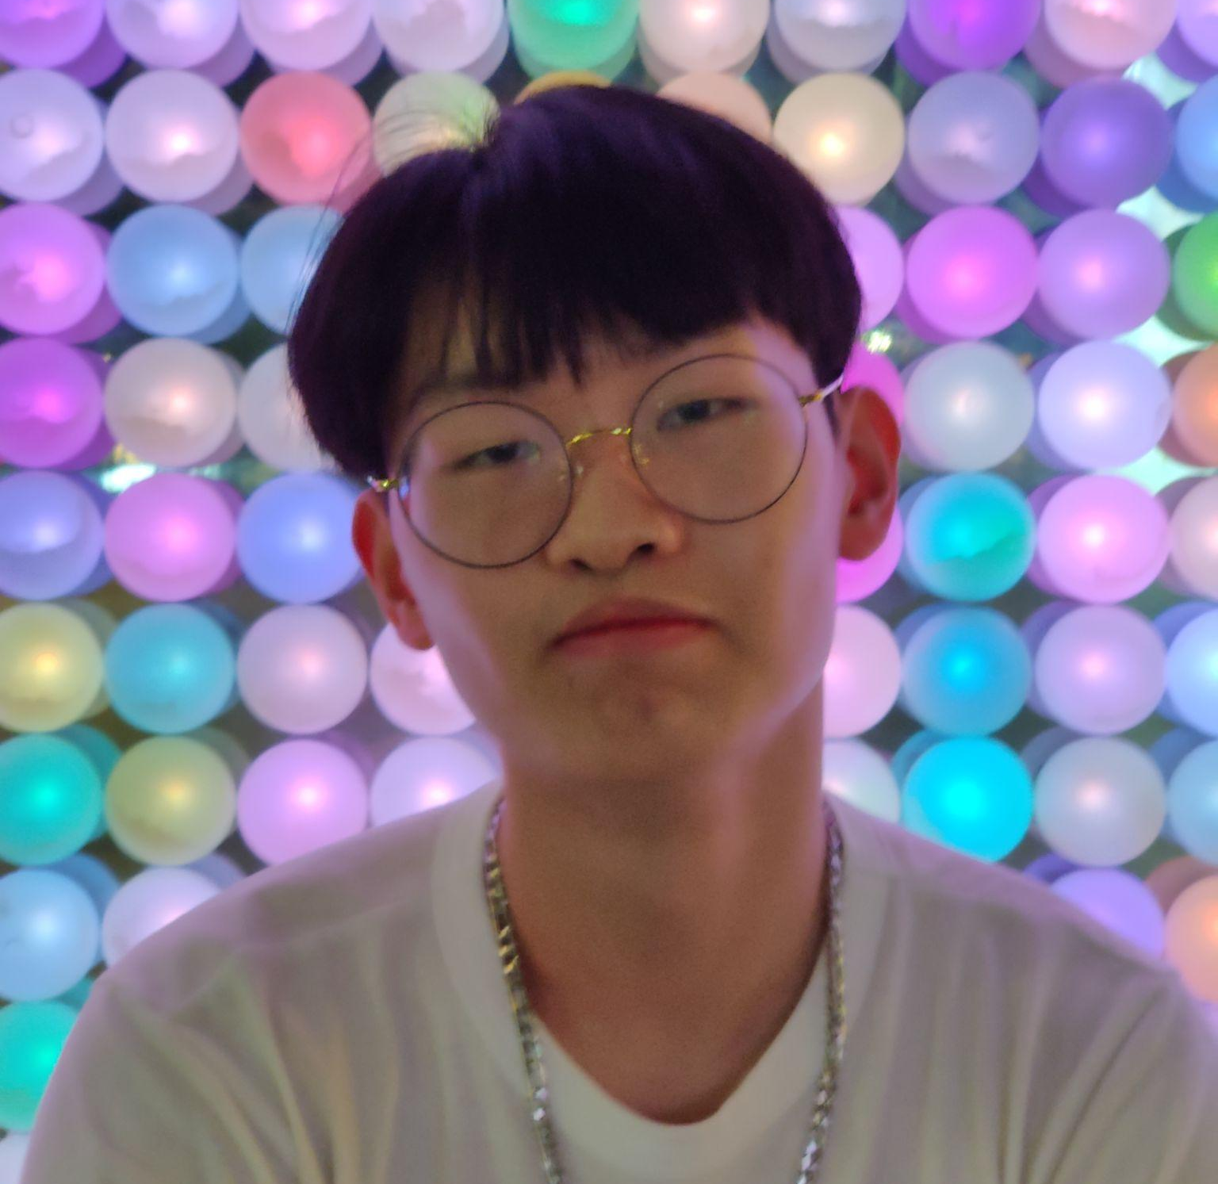


Who are we?
Mickaël Chau
EPITA APPRENTICE 2024 Google Cloud
DevOps & Cloud Lead

Slide 6
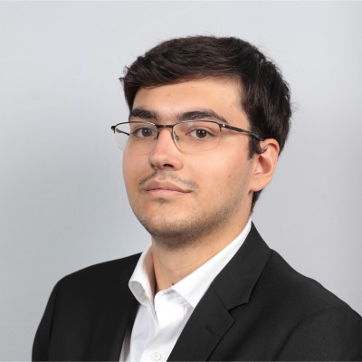

Who are we?
Mickaël Chau
EPITA APPRENTICE 2024 Google Cloud
DevOps & Cloud Lead
Alexandre Dias
EPITA TCOM 2023
Telecommunication Major
DevOps & Infra Lead

Slide 7
What is Docker ?
Open platform for developing, shipping, and running applications.
Separate applications from your infrastructure → faster delivery.
Reduce the delay between writing code and running it in production.

Slide 8
Why is it useful for you?
Data/AI: Used to transform your data
Cybersecurity: Most of the modern architecture uses containers
Dev: Containers are the preferred way to ship your application to production

Slide 9
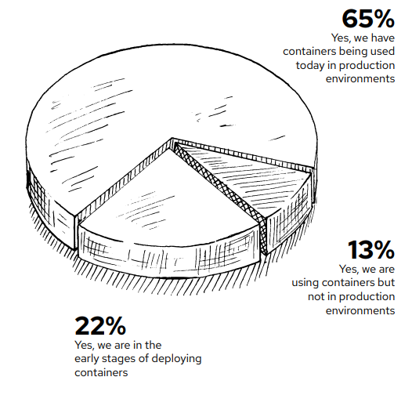
¨Are you currently using containers in your IT environment?¨

Slide 10
65% of the companies use containers in production (link)

Slide 11
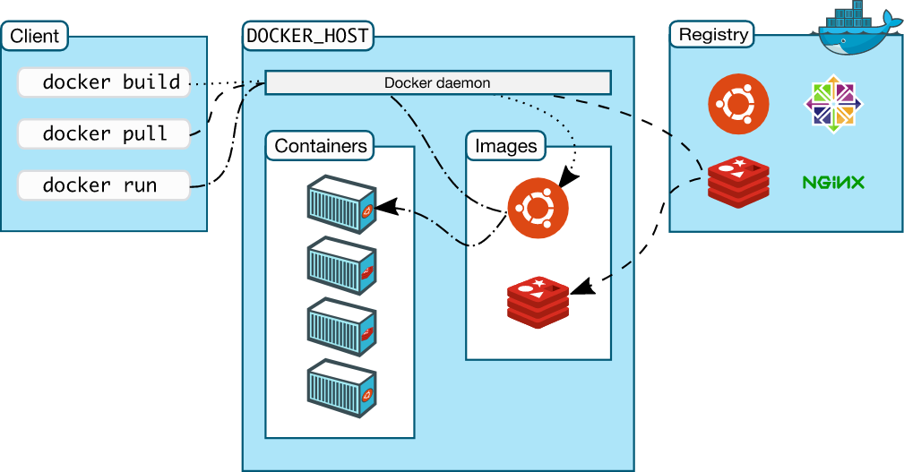
Docker definitions
Images
Template with instructions
Containers
Runnable instance of an
image
Client
Commands to build and run containers from images

Slide 12
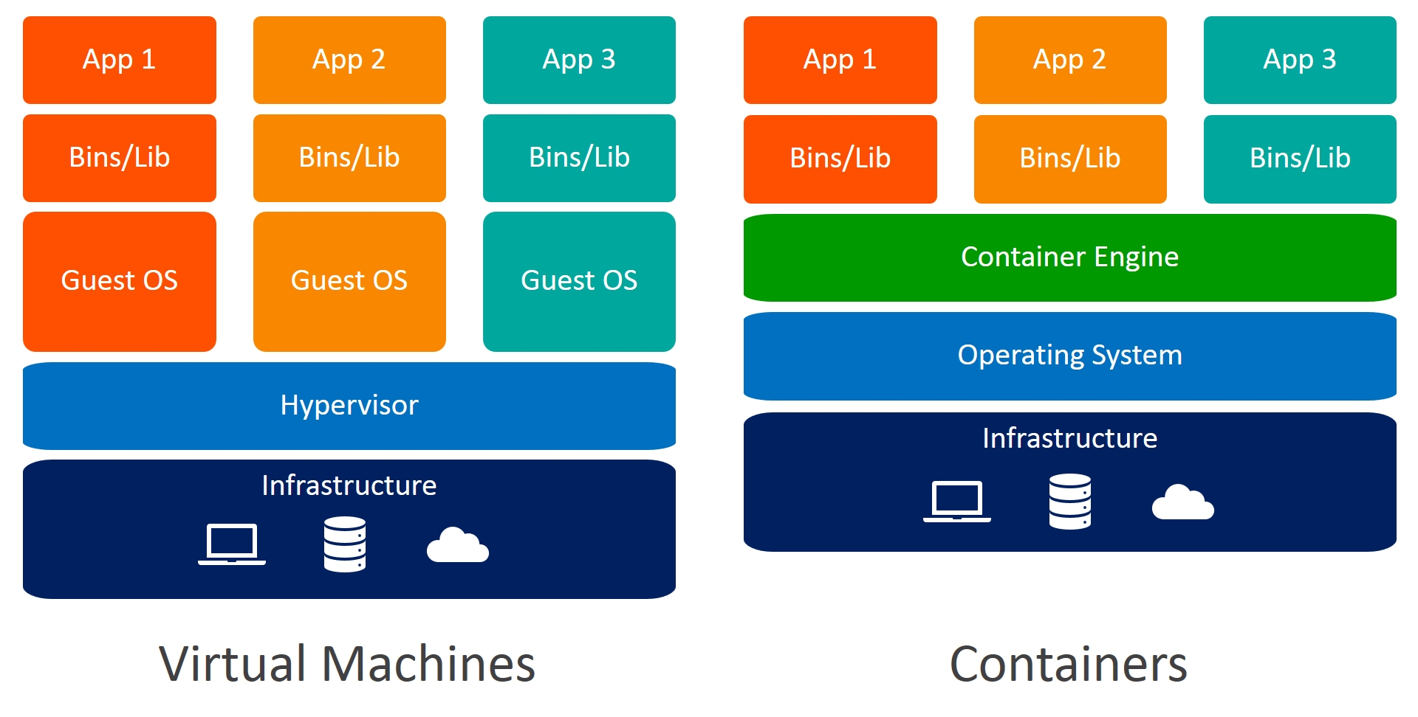
VM vs Containers

Slide 13

Simple example
Write code locally
Share it with Docker containers
Use docker to run your application in a test environment
Execute automated and manual tests
Find bugs, Fix them
Redeploy to the test environment for testing and validation
Send the updated image to production

Slide 14

Other Runtimes

Slide 15

Most Accessible way to expose your application
Caas (Container As A Service)→Demo

Slide 16

Next Step with containers: Kubernetes

Slide 17

…But how does it work?
For this workshop
Using Docker
On Github:
https://github.com/GDSC-EPITA/gdsc-docker-epita
The task
Follow the tutorial to learn how to use docker

Slide 18
Thank you!
Any questions?

